Slide 1
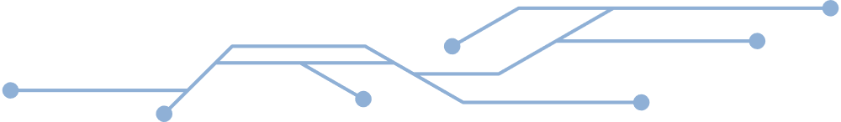


Sigurnost informacijskih sustava
Implementacija DMARC-a
(Domain-Based Message Authentication, Reporting & Conformance)
Mentor: Izv. prof. dr. sc. Igor Tomičić
Tim17: Ennio David Komljenović, Marko Mencl, Filip Novak, Paula Zadravec
Learn More

Slide 2

Praktičan dio
Postavljanje mail server okruženja
SPF, DKIM, DMARC
Python skripta za napade
Načini povećanja sigurnosti
Analiza DMARC izvještaja

Slide 3
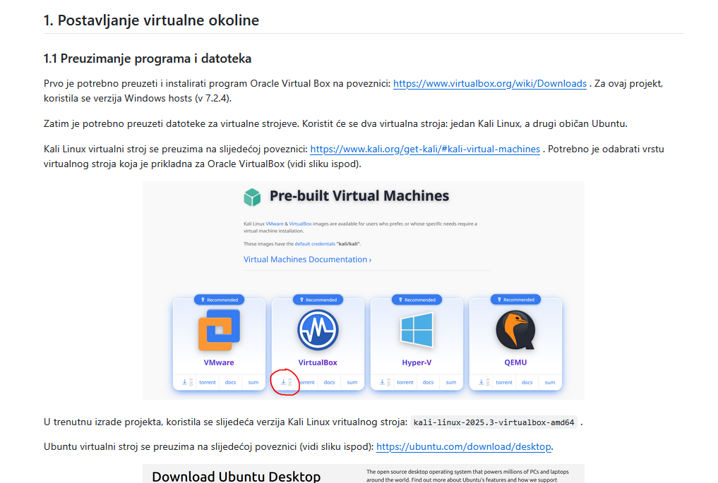
Postavljanje lokalnog email okruženja – detaljne upute

Slide 4

LAB okruženje - skica arhitekture
NAT
NAT
kali-mail.lab
mail-server.lab
Lokalni DNS
(BIND9) kali-mail.lab
Lokalni DNS
(BIND9)
mail-server.lab
SPF
DMARC
DKIM
SPF
DMARC
DKIM
Internal network
Mail server
(Postfix)
Mail server
(Postfix)

Slide 5
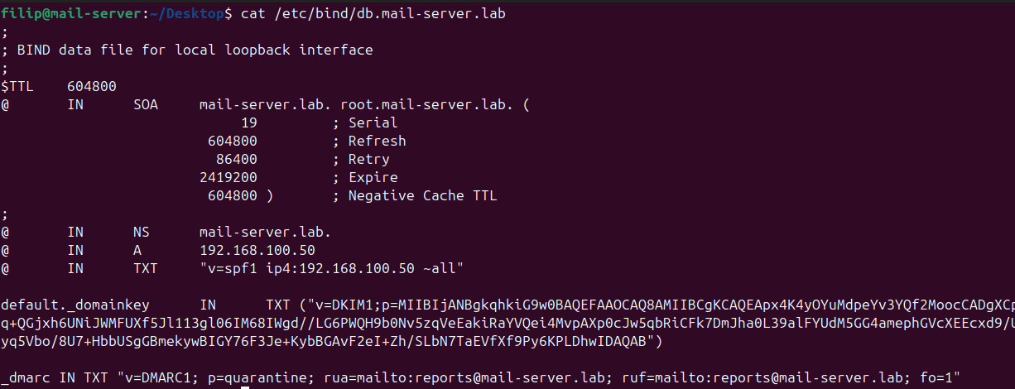
DNS
Bind9 – Lokalni DNS server
SPF
DKIM
DMARC

Slide 6
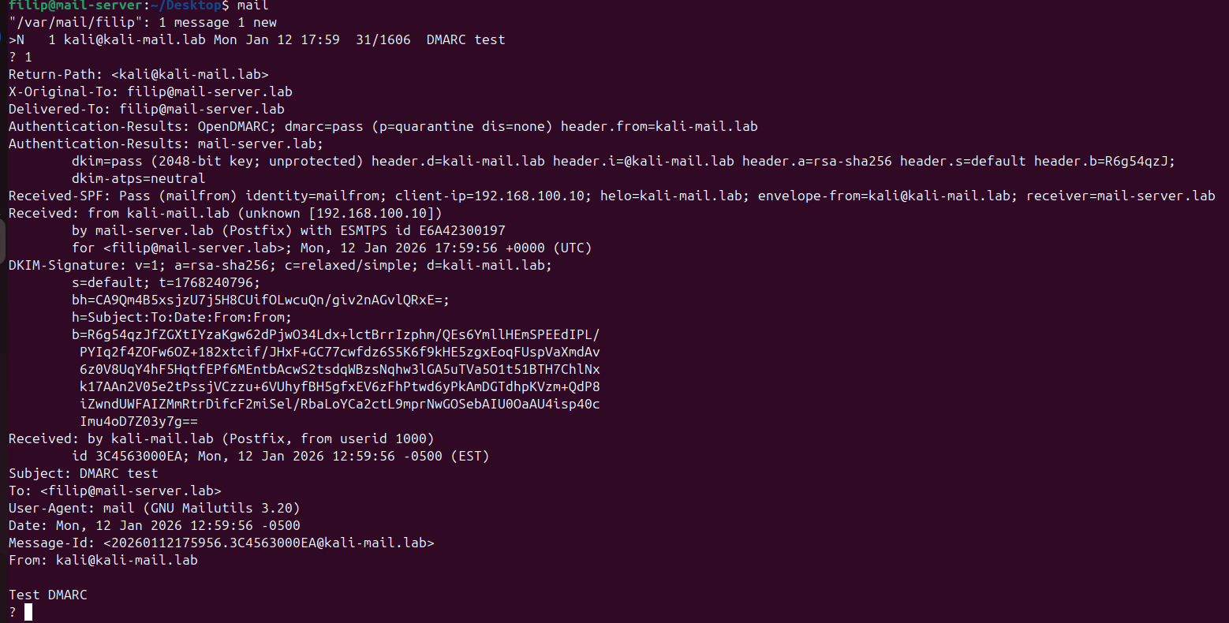
ISPRAVNI MAIL pass

Slide 7
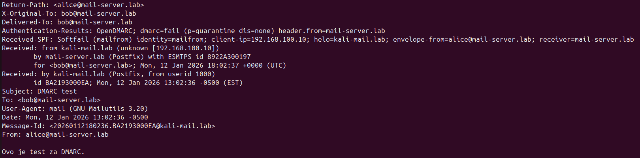
SPOOFANI MAIL fail

Slide 8
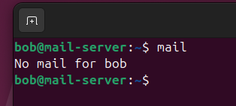

DMARC p=reject

Slide 9
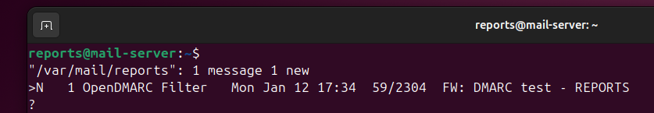
DMARC Forenzički report

Slide 10
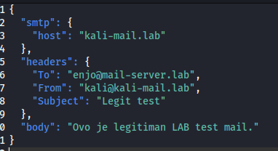
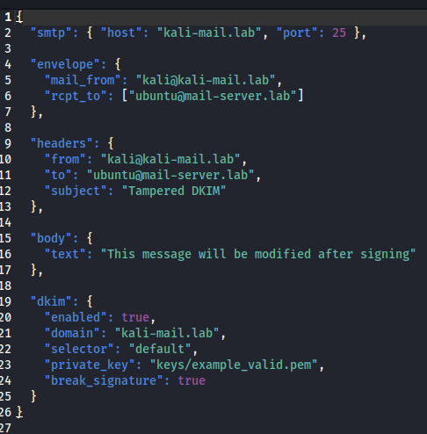
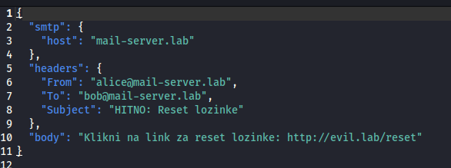
Legit mail
E-mail napadi
Tampered mail
Spoofed mail

Slide 11

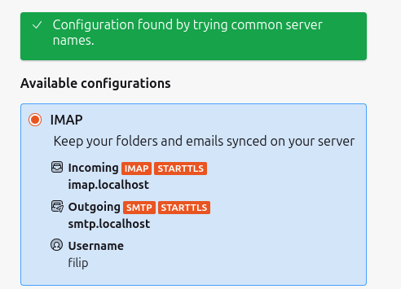
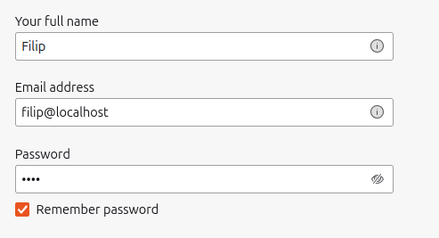
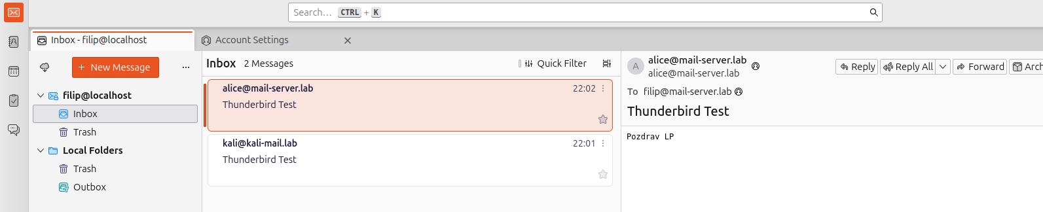
Thunderbird – email klijent
Dovecot (omogućuje IMAP i POP3)

Slide 12

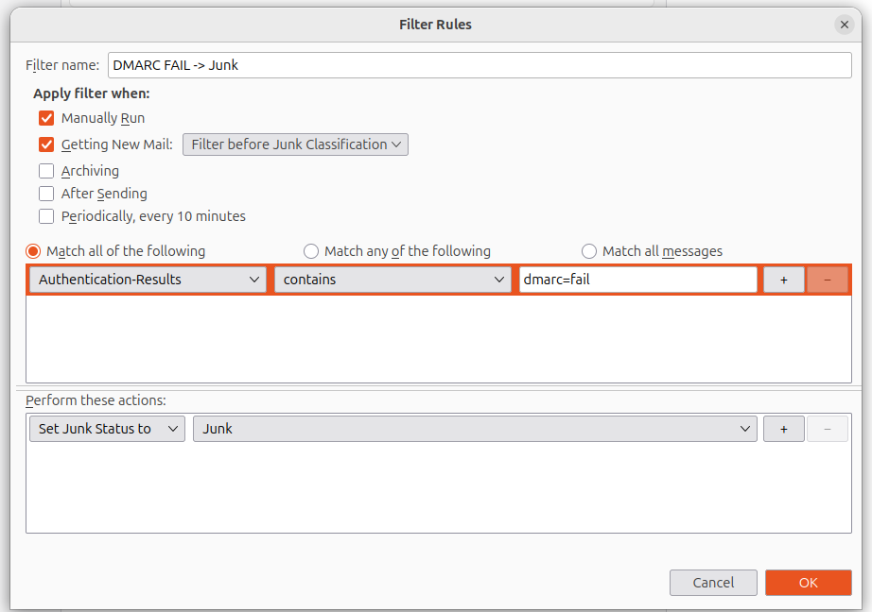
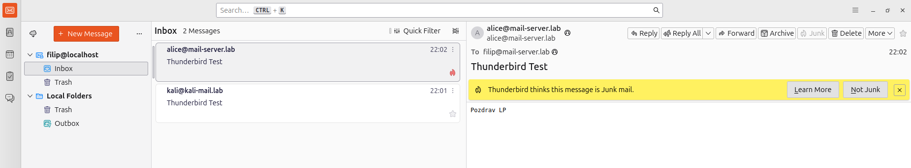
Thunderbird – postavljanje oznake spam mailova

Slide 13
Milter
Ekstenzija za Mail Transfer Agents (MTA)
Mogu služiti za:
filtriranje mailova
skeniranje malwarea
dodavanje i provjera digitalnih potpisa
Poput “cijevi” se nadovezuje na ostale protokole

Slide 14
Vlastiti Milter
Služi za detekciju phising napada
Nudi sljedeće mogućnosti prepoznavanja:
ključnih riječi
sumnjivih linkova
sumnjivih IP adresa
base64 enkodiranja
hex enkodiranja
HTML-a
JS-a
obfuskaciju

Slide 15
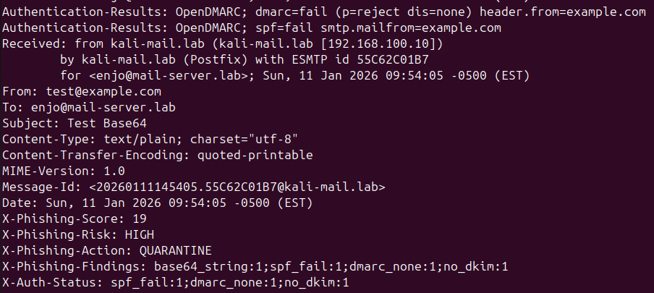
Base64 mail

Slide 16
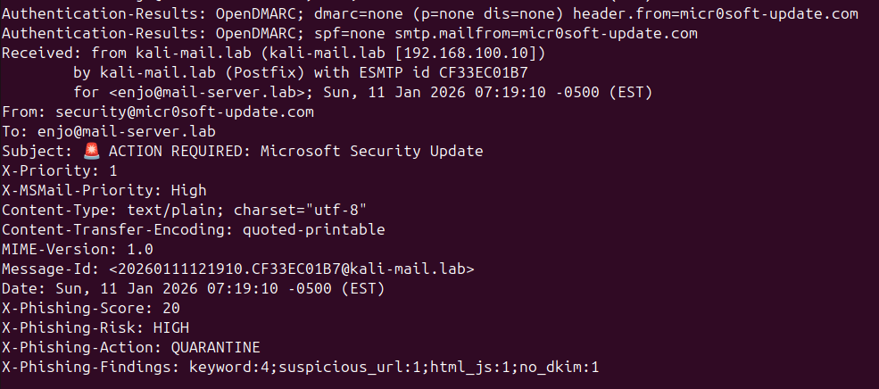
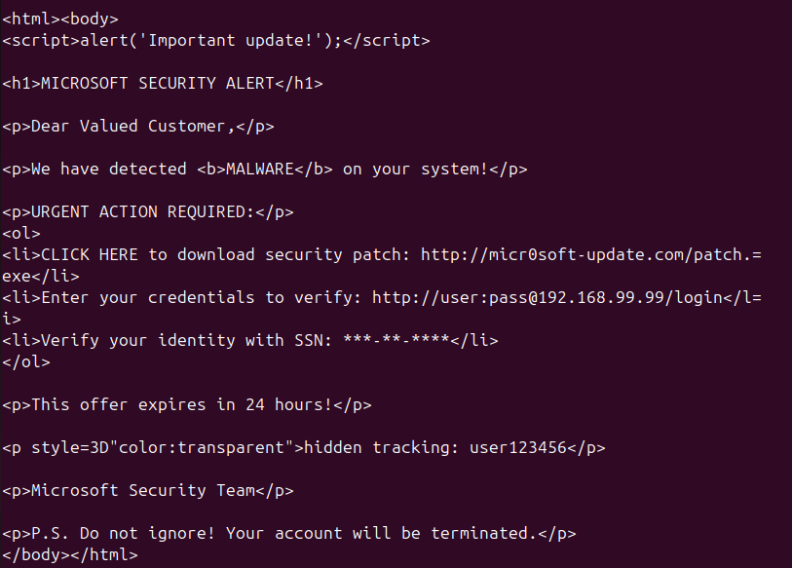
HTML mail

Slide 17
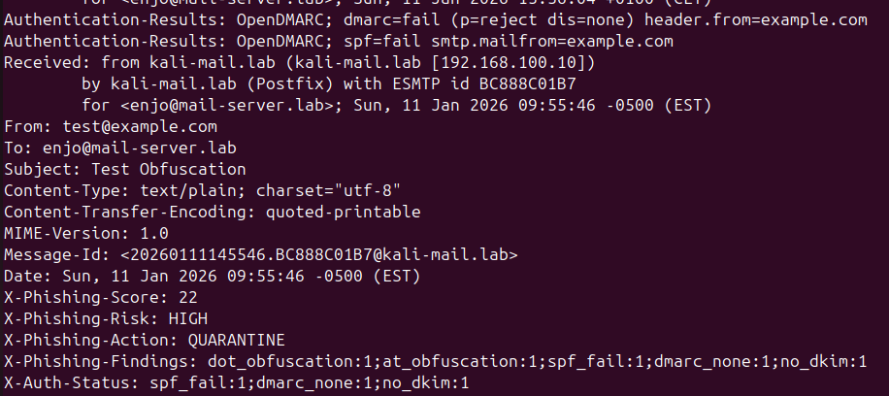
Obfuskirani mail

Slide 18
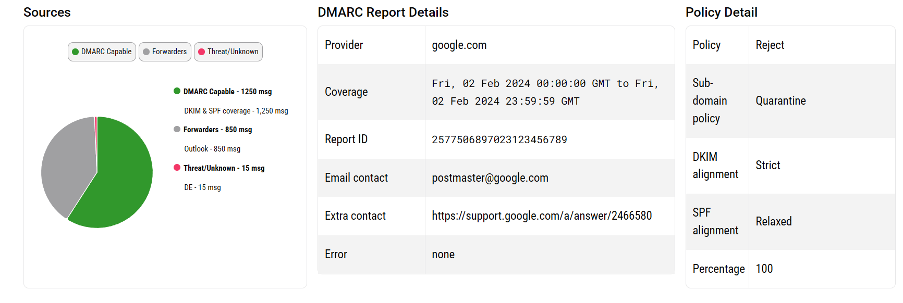
Analiza DMARC izvještaja – dmarcian

Slide 19
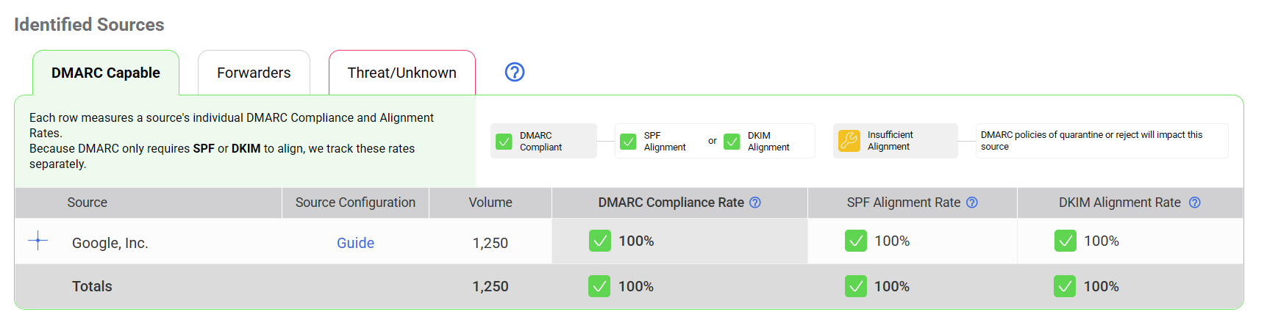
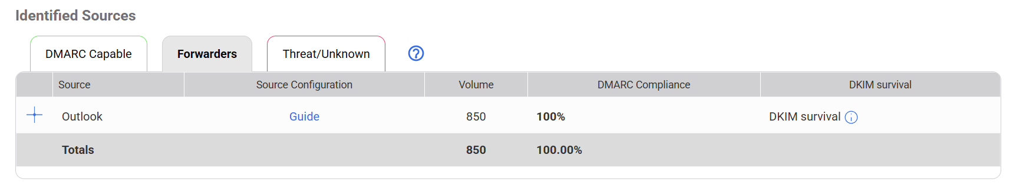
Analiza DMARC izvještaja – dmarcian

Slide 20
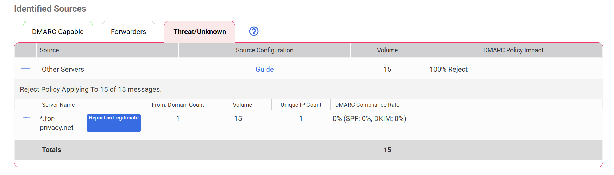
Analiza DMARC izvještaja – dmarcian

Slide 21
Zaključak
Pravilno konfiguriranje E-mail servera – danas JAKO važno!
Potrebno razumijevanje:
DNS
SPF, DKIM, DMARC
Phishing, Spoofing
Mnogo opcija – veća mogućnost pogrešne konfiguracije
Preporučlijvo – prvo testirati u kontroliranom okruženju

Slide 22

Literatura
Crocker, D., Hansen, T., i Kucherawy, M. (Eds.). (2011). DomainKeys Identified Mail (DKIM) signatures (RFC 6376). Internet Engineering Task Force. https://www.rfc-editor.org/rfc/rfc6376 (DOI: https://doi.org/10.17487/RFC6376)
dmarcian. (bez dat.). Getting started with DMARC. dmarcian. https://dmarcian.com/getting-started-with-dmarc/
dmarcian. (2020). What is a DMARC record? dmarcian. https://dmarcian.com/what-is-a-dmarc-record/
dmarcian. (bez dat.). Why DMARC? dmarcian. https://dmarcian.com/why-dmarc/
DuoCircle. (bez dat.). SPF neutral and other types of SPF error messages you could encounter after setting SPF records for your domain. DuoCircle. https://www.duocircle.com/content/spf-permerror/spf-neutral
Fortinet. (bez dat.). DMARC. Fortinet. https://www.fortinet.com/resources/cyberglossary/dmarc
Görling, S. (2007). An overview of the Sender Policy Framework (SPF) as an anti-phising mechanism. Internet Research, 17(2), 169–179. https://doi.org/10.1108/10662240710737022
Leiba, B., i Fenton, J. (2007). DomainKeys Identified Mail (DKIM): Using digital signatures for domain verification. CEAS 2007. https://www.researchgate.net/publication/221650803_DomainKeys_Identified_Mail_DKIM_Using_Digital_Signatures_for_Domain_Verification
Loshin, P. (2024). Email authentication: How SPF, DKIM and DMARC work together. TechTarget. https://www.techtarget.com/searchsecurity/answer/Email-authentication-How-SPF-DKIM-and-DMARC-work-together
Sethuraman, S. C., Devi Priya, V. S., Reddi, T., Mulka Sai Tharun Reddy, R., i Khan, M. K. (2024). A comprehensive examination of email spoofing: Issues and prospects for email security. Computers & Security, 137, 103600. https://doi.org/10.1016/j.cose.2023.103600
WMD Hosting. (n.d.). Što je SPF zapis? WMD Hosting. https://wmd.hr/upute/%C5%A1to-je-spf-zapis

Slide 23
Literatura
https://www.linkedin.com/pulse/how-build-your-own-email-server-ubuntu-part-4-liviu-gelca-gda0e
https://askubuntu.com/questions/965343/enabling-and-disabling-network-card-through-commandline
https://serverfault.com/questions/1021262/whats-the-right-way-to-enter-dkim-string-into-bind-zone-file
https://stackoverflow.com/questions/43720476/setting-up-dkim-setup-dns-zone-syntax-error-on-bind-in-ubuntu
https://support.dnsimple.com/articles/txt-record-format/
https://blog.matrixpost.net/set-up-dmarc-for-postfix-on-ubuntu/
https://www.linuxbabe.com/mail-server/create-dmarc-record
https://www.server-world.info/en/note?os=CentOS_Stream_9&p=dns&f=10
https://dovecot.org/
https://www.thunderbird.net/en-US/

Slide 24
HVALA NA PAŽNJI!

Slide 25


